Slide 1
CS595—Big Data Technologies
Module 3b
Map Reduce (Part 1)

Slide 2
Processing Big Data
The only feasible approach to tackling large data problems today is to divide and conquer, a fundamental concept in computer science
The basic idea is to partition a large problem into smaller sub-problems.
To the extent that the sub-problems are independent, they can be tackled in parallel by different workers
Threads in a processor core, cores in a multi-core processor
Multiple processors in a machine, or many machines in a cluster
Intermediate results from each individual worker are then combined to yield the final output
The general principles behind divide-and-conquer algorithms are broadly applicable to a wide range of problems in many different application domains
However, the details of algorithm implementation are varied and complex

Slide 3
Processing Big Data Challenges
How do we break up a large problem into smaller tasks?
More specifically, how do we decompose the problem so that the smaller tasks can be executed in parallel?
How do we assign tasks to workers distributed across a potentially large number of machines?
While keeping in mind that some workers are better suited to running some tasks than others, e.g., due to available resources, locality constraints, etc
How do we ensure that the workers get the data they need?
How do we coordinate synchronization among the different workers?
How do we share partial results from one worker that is needed by another?
How do we accomplish all of the above in the face of software errors and hardware faults?

Slide 4
MapReduce An Execution Framework for Big Data Processing
A programming model for expressing distributed computations on massive amounts of data and an execution framework for large-scale data processing on clusters of commodity servers
Originally developed by Google and built on well-known principles in parallel and distributed processing
Has since enjoyed widespread adoption via an open-source implementation in Hadoop
Addresses the challenges of distributed programming by providing an abstraction that isolates the developer from system-level details (e.g., locking of data structures, data starvation issues in the processing pipeline, etc.)
The programming model specifies simple and well-defined interfaces between a small number of components, and therefore is easy for the programmer to reason about.

Slide 5


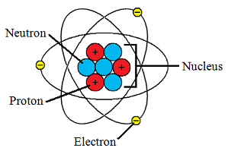

MapReduce Concepts
Start with a large
volume of data
in one arrangement
Break the data down
into its smallest parts
Process those
small parts in
parallel
And group them
into a new and
informative whole

Slide 6
MapReduce Concepts
MapReduce can refer to three distinct but related ideas
First, MapReduce is a programming model, which is the sense discussed above
Second, MapReduce can refer to the execution framework (i.e., the “runtime”) that coordinates the execution of programs written in this particular style
Finally, MapReduce can refer to the software implementation of the programming model and the execution framework

Slide 7
MapReduce Concepts
Large-data processing by definition requires bringing data and code together for computation to occur—no small feat for datasets that are terabytes and perhaps petabytes in size
MapReduce addresses this challenge by providing a simple abstraction for the developer, transparently handling most of the details behind the scenes in a scalable, robust, and efficient manner
Instead of moving large amounts of data around, it is far more efficient, if possible, to move the code to the data
This is operationally realized by spreading data across the local disks of nodes in a cluster and running processes on nodes that hold the data
The complex task of managing storage in such a processing environment is handled by the Hadoop Distributed File System that sits underneath MapReduce.

Slide 8
MapReduce Concepts
However, as anyone who has taken an introductory computer science course knows, abstractions manage complexity by hiding details and presenting well-defined behaviors to users of those abstractions.
They, inevitably, are imperfect—making certain tasks easier but others more difficult, and sometimes, impossible
This critique applies to MapReduce: it makes certain large-data problems easier, but suffers from limitations as well.
This means that MapReduce is not the final word, but rather the first in a new class of programming models that will allow us to more effectively organize computations at a massive scale.

Slide 9
MapReduce Concepts
Viewed from a slightly different angle, MapReduce codifies a generic “recipe” for processing large datasets that consists of two stages
Map—First a user-specified computation is applied over all input records in a dataset. These operations occur in parallel and yield intermediate output
Reduce—Next, the output is then aggregated by another user-specified computation.
The programmer defines these two types of computations, and the execution framework coordinates the actual processing
Such a two-stage processing structure may appear to be very restrictive, many interesting algorithms can be expressed quite concisely…
Especially if one decomposes complex algorithms into a sequence of MapReduce jobs.

Slide 10
Developing Some MapReduce Intuition
Most explanations of how the MapReduce framework supports the development of parallel programming algorithms start with…
Some mathematical representation
Or a diagram so complex one cannot develop any sense about what is happening
We are going to take something of a different approach and start by developing our intuition about how the Map Reduce framework functions
And then, once we have some of the fundamentals understood move on to more detail

Slide 11
Developing Some MapReduce Intuition
Let’s think through how we might take advantage of the following Hadoop capabilities we have encountered to process large volumes of data
We have a cluster of computing nodes each having some amount of CPUs, RAM and storage
We have a distributed file systems that takes a large file, decomposes it into blocks, and then stores them across the nodes of our cluster
And we have a means to launch applications comprised of multiple tasks and distribute them across the cluster

Slide 12
Developing Some MapReduce Intuition
So our first thought might be: let’s run an application with a task on each node where some block of a file I want to process is located
That is a good start; we can execute searches and sorts or filtering operations on each block in parallel

Slide 13
Developing Some MapReduce Intuition Challenges
We need to make sure that our application is fault tolerant
That is tolerant of node, software and network failures that might happen in a distributed environment
We also need to somehow merge and finish processing together the output of the tasks that have executed on each node
That is support data sharing and synchronization across multiple application tasks
Our file was decomposed into blocks without regard to record boundaries
But what we really want to do is get each record from a block and process it
But because of the naïve way the file is stored in blocks some records may cross block boundaries
All these details and more are complicated, and I want things simple
I want to use a framework that I can customize by just a small amount to do what I want
This framework should work well with YARN and other aspects of the Hadoop environment including security.

Slide 14
Developing Some MapReduce Intuition
It is by this sort of thinking we arrive at the Hadoop MapReduce execution engine
It is a framework which addresses the above challenges and more
It does so in a way that makes it comparatively simple to write parallel processing algorithms
But, as we shall see, as with all engineered systems we have to accept some tradeoffs to take advantage of this framework

Slide 15



Let’s illustrate with an example
How many movies did each user rate in the MovieLens data set?

Slide 16
How MapReduce Works: Mapping
The MAPPER converts raw source data into key/value pairs
INPUT DATA
Mapper
K1:V K2:V K3:V K1:V K1:V

Slide 17
Example: MovieLens Data (u.data file)
USER ID|MOVIE ID|RATING|TIMESTAMP
196 | 242 | 3 | 881250949
186 | 302 | 3 | 891717742
196 | 377 | 1 | 878887116
244 | 51 | 2 | 880606923
166 | 346 | 1 | 886397596
186 | 474 | 4 | 884182806
186 | 265 | 2 | 881171488

Slide 18
Map users to movies they watched
USER ID|MOVIE ID|RATING|TIMESTAMP
196 242 3 | 881250949
186 302 3 | 891717742
196 377 1 | 878887116
244 51 2 | 880606923
166 346 1 | 886397596
186 474 4 | 884182806
186 265 2 | 881171488
Mapper
196:242 186:302 196:377 244:51 166:346 186:274 186:265

Slide 19
Extract and Organize What We Care About
196:242 186:302 196:377 244:51 166:346 186:274 186:265

Slide 20
MapReduce Sorts and Groups the Mapped Data (“Shuffle and Sort”)
196:242 186:302 196:377 244:51 166:346 186:274 186:265
166:346
186:302,274,265
196:242,377
244:51

Slide 21
The REDUCER Processes Each Key’s Values
166:34 186:302,274,265 196:242,377
len(movies)
166:1 186:3 196:2 244:1
244:51

Slide 22
Putting it All Together
USER ID|MOVIE ID|RATING|TIMESTAMP
196 | 242 | 3 | 881250949
186 | 302 | 3 | 891717742
196 | 377 | 1 | 878887116
244 | 51 | 2 | 880606923
166 | 346 | 1 | 886397596
186 | 474 | 4 | 884182806
186 | 265 | 2 | 881171488
MAPPER
196:242 186:302 196:377 244:51 166:346 186:274 186:265
SHUFFLE AND SORT
186:302,274,265 196:242,377
166:346
244:51
REDUCER
166:1 186:3 196:2 244:1

Slide 23
Developing Some MapReduce Intuition A Little About MapReduce as a Framework
Most frameworks have a core of services and offer hooks for you to add custom code
These hooks are generally member functions that must accept specified input types and return specified output types
Framework users code this functions and register them with the framework
The MapReduce framework supports hooks for functions such as map, reduce and others
Map Function
register with
framework
MapReduce Framework
register with
framework
Reduce Function

Slide 24
Developing Some MapReduce Intuition A Little About MapReduce as a Framework
Most frameworks provide data to user member functions and otherwise manage it
And this data may be of any type useful to the framework user
But this means the framework must have a means to hold and pass data of unknown types
The way most frameworks handle this is to place user data types is a “wrapper”

Slide 25
Developing Some MapReduce Intuition A Little About MapReduce as a Framework
So the framework uses the wrapper means to handle and move data
To hold a wide range of user data types, this wrapper must be very generic
The MapReduce framework wraps data in key value pairs
The pairs are used to pass user data types between the hook functions and the framework
Part of the design of MapReduce algorithms involves imposing this key value structure on arbitrary datasets
Map Function
MapReduce Framework
KVP
Reduce Function
KVP

Slide 26
Developing Some MapReduce Intuition A Little About MapReduce as a Framework
A set of two data items: a key, which is a unique identifier for some item of data, and the value, which is either the data that is identified or a pointer to the location of that data.
The key and value can be either simple or complex types. For example, here are simple key value pairs
<“hello”, 5>
<”hello”, “there”>
Key value pairs can also be complex
<”hello”, list(1, 2, 3, 4, 5)>
<struct(“a”, 5), “hello”>

Slide 27
Developing Some MapReduce Intuition A Little About MapReduce as a Framework
Key-value pairs form the basic data structure in MapReduce.
Keys and values may be primitives such as integers, floating point values, strings, and raw bytes, or they may be arbitrarily complex structures (lists, tuples, associative arrays, etc.).
Part of the design of MapReduce algorithms involves imposing the key-value structure on arbitrary datasets

Slide 28
Developing Some MapReduce Intuition A Little About MapReduce as a Framework
For a collection of web pages, keys may be URLs and values may be the actual HTML content.
For a graph, keys may represent node ids and values may contain the adjacency lists of those nodes
In some algorithms, input keys are not particularly meaningful and are simply ignored during processing,
While in other cases input keys are used to uniquely identify a datum (such as a record id)

Slide 29
MapReduce Framework Workflow
MapReduce splits the input data into independent chunks generally aligned with HDFS file blocks
Each of these chunks is processed by map functions in a completely parallel manner
But what if some of the output from a map function should be grouped for further processing with the output of some other map function
Recall each map functions executes on a different node with a separate file system
So each map function also indicates which subset of the data it outputs should be processed as a unique group

Slide 30
MapReduce Framework Workflow
The MapReduce framework collects the map output from each node for a group
The data of the same group from all map nodes is then assembled together then presented to a reduce function
The reduce function processes data from multiple nodes which should, as a final step, be processed together
The output of each reduce function is saved to an HDFS file

Slide 31

MapReduce Framework Conceptual Landscape
Map Phase
Reduce Phase
Process one KVP
(from intermediate KVPs)
for this reducer
at a time until done
Process one KVP
(from input record)
at a time until done
Records
Input
FIle
Read Record
Map
Phase
Shuffle & Sort
Reduce
OutputFIle
KVP
KVP
Wait for
all mappers
to finish
2) Distribute
mapper KVPs
to reducers
KVP
Record Reader
Funct
Map
Funct
Reduce
Funct

Slide 32
MapReduce Framework Operational View
File X
Block1
Block2
Block3
Data Node
Data Node
Data Node
Split blocks at
record boundaries
Split
Split
Split
Process the split
block
Map
Map
Map
Place data into
groups
Group1
Group2
Group1
Group2
Group1
Group2
Combine and
sort like groups
by key
Shuffle and Sort
Group1
sorted by key
Group2
sorted by key
Process the
grouped data
Reduce
Reduce

Slide 33
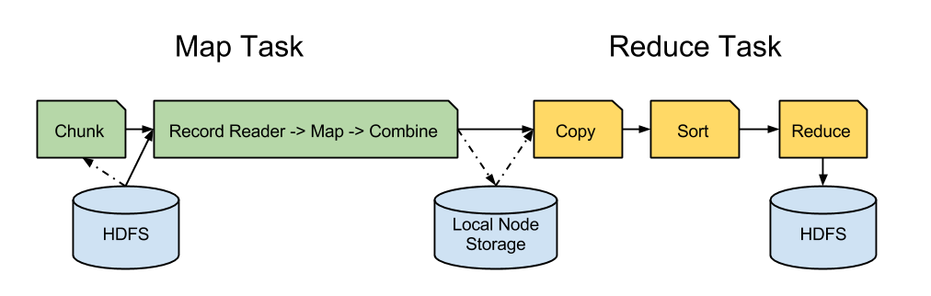
MapReduce Framework Dataflow View

Slide 34
MapReduce Framework General Characteristics
Maintains a separation of what computations are to be performed and how those computations are actually carried out on a cluster of machines.
The first is under the control of the programmer, while the second is exclusively the responsibility of the execution framework
The advantage is that the execution framework only needs to be designed once and verified for correctness
As long as the developer expresses computations in the programming model, code is guaranteed to behave as expected.
The upshot is that the developer is freed from having to worry about system-level details and can instead focus on algorithm or application design
No more debugging race conditions and addressing lock contention

Slide 35
MapReduce Framework Libraries
Java
Maximum flexibility
Fastest performance
Native to Hadoop
Most difficult to write
Hadoop Streaming
A utility that comes with the Hadoop distribution
Allows you to create and run Map/Reduce jobs with any executable or script as the mapper and/or the reducer
Transparent communication with Hadoop though stdin/stdout

Slide 36
MapReduce Framework Libraries
mrjob
Write MapReduce jobs in Python!
Open sourced and maintained by Yelp
Wraps “Hadoop Streaming” in cpython Python 2.5+
Well documented
Can run locally, in Amazon EMR, or Hadoop
We will use mrjob for our class work

Slide 37
MapReduce Example
WordCount is a simple program which counts the number of occurrences of each word in a given text input data set.
WordCount fits very well with the MapReduce model making it a great example to understand the Hadoop Map/Reduce programming style.
Our implementation consists of three main parts:
Mapper function
Reducer function
Main program (hooking our functions into the framework)

Slide 38
MapReduce Example
Data Node
HDFS File
Data Node
Mapper
Hello Hadoop world, hello
Block
1
Mapper
Goodbye sad sad world
Block
2
<Hello, 1>
<Hadoop, 1>
<world, 1>
<hello, 1>
Data Node
<Goodbye, 1>
<sad, 1>
<sad, 1>
<world, 1>
Reducer
HDFS File
<Goodbye, 1>
<Hadoop, 1>
<Hello, 1>
<hello, 1>
<sad, 2>
<world, 2>

Slide 39
WordCount Driver
The first chunk of code we’ll look at is the driver.
The driver takes all of the components that we’ve built for our MapReduce job and pieces them together to be submitted to execution
This code is usually pretty generic and considered “boiler plate.”
You’ll find that in all of our patterns the driver stays the same for the most part

Slide 40
WordCount Driver
from mrjob.job import MRJob
class MRClassName(MRJob):
def mapper(self, _, value):
// some mapper logic
def reducer(self, key, values):
// some reducer logic
if __name__ == '__main__':
MRClassName.run()

Slide 41
WordCount Mapper
Next is the mapper code that parses and prepares the text
The text string is split up into a list of words
Then the intermediate key produced is the word and the value produced is simply “1.”
This means we’ve seen this word once.
Even if we see the same word twice in one line, we’ll output the word and “1” twice and it’ll be taken care of in the end
Eventually, all of these ones will be summed together into the global count of that word

Slide 42
WordCount Mapper
The mapper is where we’ll see most of the work done.
We don’t care about the key of the input in this case which is the file offset of the next record read
The input value (and key) are strings
If you need to process the value (or part of it) as a float, integer or some other type you need to do the conversion yourself
Our output key and value must also be strings

Slide 43
WordCount Mapper
from mrjob.job import MRJob
import re
WORD_RE = re.compile(r"[\w']+")
class MRWordCount(MRJob):
def mapper(self, _, line):
for word in WORD_RE.findall(line):
yield (word.lower(), 1)

Slide 44
WordCount Reducer
Next comes the reducer code, which is relatively simple
The reduce function gets called once per key grouping, in this case each word
We’ll iterate through the values, which will be numbers, and take a running sum
The final value of this running sum will be the sum of the ones
As in the mapper the key is a string

Slide 45
WordCount Reducer
The reduce function has a different signature from map, though
It gives you an Iterator over values instead of just a single value
This is because you are now iterating over all values that have that key instead of just one at a time
The key is very important in the reducer of pretty much every MapReduce job, unlike the input key in the map
Each reducer will create one file
so if you want to coalesce them together you’ll have to write a post-processing step to concatenate them

Slide 46
WordCount Reducer
def reducer(self, word, counts):
yield (word, sum(counts))

Slide 47
Canonical Word Count
from mrjob.job import MRJob
import re
WORD_RE = re.compile(r"[\w']+")
class MRWordCount(MRJob):
def mapper(self, _, line):
for word in WORD_RE.findall(line):
yield (word.lower(), 1)
def reducer(self, word, counts):
yield (word, sum(counts))
if __name__ == '__main__':
MRWordCount.run()

Slide 48
Canonical Word Count
from mrjob.job import MRJob
import re
WORD_RE = re.compile(r"[\w']+")
class MRWordFreqCount(MRJob):
def mapper(self, _, line):
for word in WORD_RE.findall(line):
yield (word.lower(), 1)
def reducer(self, word, counts):
yield (word, sum(counts))
if __name__ == '__main__':
MRWordFreqCount.run()
The quick brown fox jumps over the lazy dog
the, 1
quick, 1
brown, 1
fox, 1
jumps, 1
over, 1
the, 1
lazy, 1
dog, 1

Slide 49
Canonical Word Count
from mrjob.job import MRJob
import re
WORD_RE = re.compile(r"[\w']+")
class MRWordFreqCount(MRJob):
def mapper(self, _, line):
for word in WORD_RE.findall(line):
yield (word.lower(), 1)
def reducer(self, word, counts):
yield (word, sum(counts))
if __name__ == '__main__':
MRWordFreqCount.run()
dog, [1, 1, 1, 1, 1, 1]
dog, 6

Slide 50
Another Example: How many of each movie rating exist?
MAP each input line to (rating, 1)
REDUCE each rating with the sum of all the 1’s
USER ID|MOVIE ID|RATING|TIMESTAMP
196 242 3 | 881250949 | ^{3,1} Shuffle
186 302 3 | 891717742 _{Map} 3,1 _{& Sort} 1 -> 1, 1 _{Reduce} 1, 2
196 377 1 | 878887116 | 1,1 | 2 -> 1, 1 | 2, 2
244 51 2 | 880606923 | 2,1 | 3 -> 1, 1 | 3, 2
166 346 1 | 886397596 | 1,1 | 4 -> 1 | 4, 1
186 474 4 | 884182806 | 4,1
186 265 2 | 881171488 | 2,1

Slide 51
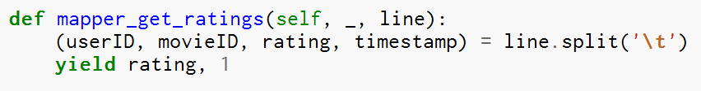
Writing the Mapper
USER ID|MOVIE ID|RATING|TIMESTAMP
196 242 3 | 881250949 | ^{3,1} Shuffle
186 302 3 | 891717742 _{Map} 3,1 _{& Sort} 1 -> 1, 1 _{Reduce} 1, 2
196 377 1 | 878887116 | 1,1 | 2 -> 1, 1 | 2, 2
244 51 2 | 880606923 | 2,1 | 3 -> 1, 1 | 3, 2
166 346 1 | 886397596 | 1,1 | 4 -> 1 | 4, 1
186 474 4 | 884182806 | 4,1
186 265 2 | 881171488 | 2,1

Slide 52

Writing the Reducer
USER ID|MOVIE ID|RATING|TIMESTAMP
196 242 3 | 881250949 | ^{3,1} Shuffle
186 302 3 | 891717742 _{Map} 3,1 _{& Sort} 1 -> 1, 1 _{Reduce} 1, 2
196 377 1 | 878887116 | 1,1 | 2 -> 1, 1 | 2, 2
244 51 2 | 880606923 | 2,1 | 3 -> 1, 1 | 3, 2
166 346 1 | 886397596 | 1,1 | 4 -> 1 | 4, 1
186 474 4 | 884182806 | 4,1
186 265 2 | 881171488 | 2,1

Slide 53
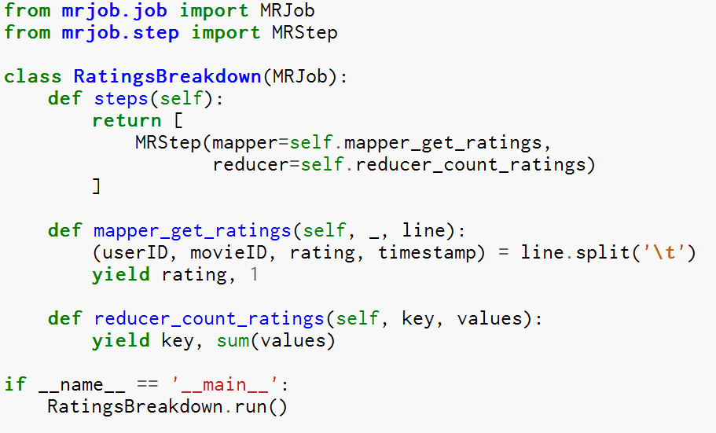
Putting it all together

Slide 54
MapReduce A More Complete Perspective
The input to a MapReduce job is a set of files in the data store that are spread out over the Hadoop Distributed File System (HDFS).
In Hadoop, these files are split with an input format, which defines how to separate a file into input splits. An input split is a byte-oriented view of a chunk of the file to be loaded by a map task
Each map task in Hadoop is broken into the following phases: record reader, mapper, combiner, and partitioner.
The output of the map tasks, called the intermediate keys and values, are sent to the reducers.
The reduce tasks are broken into the following phases shuffle, sort, reducer, and output format.
The nodes in which the map tasks run are optimally on the nodes in which the data rests.
This way, the data typically does not have to move over the network and can be computed on the local machine.

Slide 55
MapReduce A More Complete Perspective
Key Comparator
Map Phase
Input
Map
Combine
Partition
Record
Reader
Mapper
Combiner
Partitioner
Key Comparator
Reduce Phase
Shuffle & Sort
Reduce
Output
Combiner
Reducer
Output Format
= Customization Hook

Slide 56
Input Format Record Reader
The record reader translates an input split generated by input format into records.
The purpose of the record reader is to parse the data into records, but not parse the record itself.
It passes the data to the mapper in the form of a key/value pair.
Usually the key in this context is positional information and the value is the chunk of data that composes a record.

Slide 57
Mapper
In the mapper, user-provided code is executed on each key/value pair from the record reader to produce zero or more new key/value pairs, called the intermediate pairs.
The decision of what is the key and value here is not arbitrary and is very important to what the MapReduce job is accomplishing
The key is what the data will be grouped on and the value is the information pertinent to the analysis in the reducer

Slide 58
Combiner
The combiner, an optional localized reducer, can group data in the map phase
It takes the intermediate keys from the mapper and applies a user-provided method to aggregate values in the small scope of that one mapper.
For example, because the count of an aggregation is the sum of the counts of each part, you can produce an intermediate count and then sum those intermediate counts for the final result.
In many situations, this significantly reduces the amount of data that has to move over the network.
Sending (hello world, 3) requires fewer bytes than sending (hello world, 1) three times over the network.
A combiner is not guaranteed to execute, so it is an optional part of the overall algorithm

Slide 59
Combiner
Data Node
HDFS File
Data Node
Mapper
Hello Hadoop world, hello
Block
1
Mapper
Combiner
Goodbye sad sad world
Block
2
Combiner
<Hello, 1>
<Hadoop, 1>
<hello, 1>
<world, 1>
Data Node
<Goodbye, 1>
<sad, 2>
<world, 1>
Reducer
HDFS File
<Goodbye, 1>
<Hadoop, 1>
<Hello, 1>
<hello, 1>
<sad, 2>
<world, 2>

Slide 60
Combiner Word Count Example
from mrjob.job import MRJob
import re
WORD_RE = re.compile(r"[\w']+")
class MRWordCount(MRJob):
def mapper(self, _, line):
for word in WORD_RE.findall(line):
yield (word.lower(), 1)
def combiner(self, word, counts): # optimization: sum the words we've seen so far
yield (word, sum(counts))
def reducer(self, word, counts):
yield (word, sum(counts))
if __name__ == '__main__':
MRWordCount.run()

Slide 61
Partitioner
The partitioner takes the intermediate key/value pairs from the mapper (or combiner if it is being used) and splits them up into shards, one shard per reducer.
By default, the partitioner interrogates the object for its hash code, which is typically an md5sum.
Then, the partitioner performs a modulus operation by the number of reducers: key.hashCode() % (number of reducers)
This randomly distributes the keyspace evenly over the reducers, but still ensures that keys with the same value in different mappers end up at the same reducer.
The default behavior of the partitioner can be customized, and will be in some more advanced patterns, such as sorting
However, changing the partitioner is rarely necessary.
The partitioned data is written to the local file system for each map task and waits to be pulled by its respective reducer.

Slide 62
Shuffle and Sort
Probably the most complex aspect of MapReduce!
Map side
Map outputs are buffered in memory in a circular buffer
When buffer reaches threshold, contents are “spilled” to disk
Spills merged in a single, partitioned file (sorted within each partition): combiner runs here
Reduce side
First, map outputs are copied over to reducer machine
“Sort” is a multi-pass merge of map outputs (happens in memory and on disk): combiner runs here
Final merge pass goes directly into reducer

Slide 63
Shuffle and Sort

Slide 64
Reducer
The reduce task starts with the shuffle and sort step.
This step takes the output files written by all of the partitioners and downloads them to the local machine in which the reducer is running.
These individual data pieces are then sorted by key into one larger data list.
The purpose of this sort is to group equivalent keys together so that their values can be iterated over easily in the reduce task.
This phase is not customizable and the framework handles everything automatically.
The only control a developer has is how the keys are sorted and grouped by specifying a custom Comparator object.

Slide 65
Reducer
The reducer takes the grouped data as input and runs a reduce function once per key grouping.
The function is passed the key and an iterator over all of the values associated with that key.
A wide range of processing can happen in this function, as we’ll see in many of our patterns.
The data can be aggregated, filtered, and combined in a number of ways.
Once the reduce function is done, it sends zero or more key/value pair to the final step, the output format.
Like the map function, the reduce function will change from job to job since it is a core piece of logic in the solution.

Slide 66
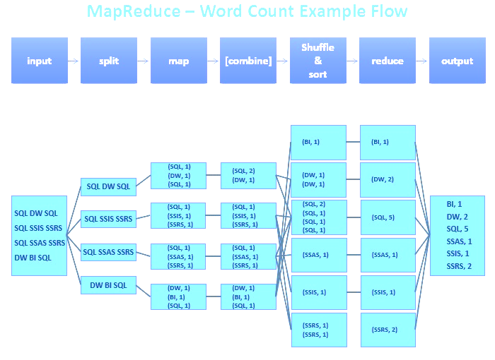
Word Count Full MapReduce Flow

Slide 67
Mappers and Reducers How Many?
Picking the appropriate count of the map and reduce tasks for a job can radically change performance Increasing the number of tasks increases the framework overhead…
But increases load balancing and lowers the cost of failures
At one extreme is the 1 map and 1 reduce case where nothing is distributed
The other extreme is to have 1,000,000 map and the 1,000,000 reduce case where framework runs out of resources

Slide 68
Mappers How Many?
An input split is a chunk of the input that is processed by a map task
Each map processes a single split
Each split is divided into records, and the map processes each record—a key-value pair—in turn
The MapReduce framework sets the number of the map tasks based on considerations of split size
Except in special circumstances the number of mappers is just generally the following…
file-size / block-size

Slide 69
Mappers How Many?
Some files, generally those compressed using techniques like gzip, are not able to be split for processing by multiple mappers
In this case the MapReduce execution engine arranges for only one map task to execute
Some applications don’t want files to be split, even where this is possible…
As this allows a single mapper to process each input file in its entirety
For example, a simple way to check if all the records in a file are sorted is…
Go through the records in order, checking whether each record is not less than the preceding one
Implemented as a map task, this algorithm will work only if one map processes the whole file

Slide 70
Reducers How Many?
By default there is a single reducer…
And therefore a single partition of data holding all the intermediate key-value pairs generated by mappers
But almost all real-world tasks should have more than one reducer…
As otherwise the MapReduce job will be very slow to execute…
Since all intermediate data flows through a single reduce task

Slide 71
Reducers How Many?
Choosing the number of reducers is often a matter of experience and trial and error
Increasing the numbers of reducers makes the reduce phase shorter by allowing parallel execution
For n reduce tasks the intermediate data will be divided into n partitions
But if you use too many reduce tasks each one may process a partition whose size is small
For a small partition the startup and shutdown of a reduce task may take more time than to process its partition
And in a shared environment with too many reduce tasks startup may be delayed by YARN until enough resources are available
Or other MapReduce jobs may be starved of needed resources

Slide 72
Reducers How Many?
Because MapReduce jobs are normally I/O-bound, it makes sense to have more tasks than cores to obtain better utilization
The amount of oversubscription depends on the CPU utilization of jobs you run
But a good rule of thumb is to have a factor of between one and two more tasks (counting both map and reduce tasks) than cores
Benchmark the job against a large but manageable data subset and tune count of reducers for best performance

Slide 73
MapReduce Framework Fault Tolerance
Map worker failure
Map tasks completed or in-progress at worker are reset to idle
Reduce workers are notified when task is rescheduled on another worker
Reduce worker failure
Only in-progress tasks are reset to idle
Master failure
MapReduce task is aborted and client is notified

Slide 74
MapReduce Framework What is in Framework Control
Limited control over data and execution flow
All algorithms must expressed in m, r, c, p
You don’t know:
Where mappers and reducers run
When a mapper or reducer begins or finishes
Which input a particular mapper is processing
Which intermediate key a particular reducer is processing

Slide 75
MapReduce Framework What is in Developer Control
The ability to construct complex data structures as keys and values to store and communicate partial results.
The ability to execute user-specified initialization code at the beginning of a map or reduce task
The ability to execute user-specified termination code at the end of a map or reduce task
The ability to preserve state in both mappers and reducers across multiple input or intermediate keys
The ability to control the sort order of intermediate keys, and therefore the order in which a reducer will encounter particular keys
The ability to control the partitioning of the key space, and therefore the set of keys that will be encountered by a particular reducer

Slide 76
Appendix

Slide 77
Compute the Mean

Slide 78
Compute the Mean (Combiner)

Slide 79
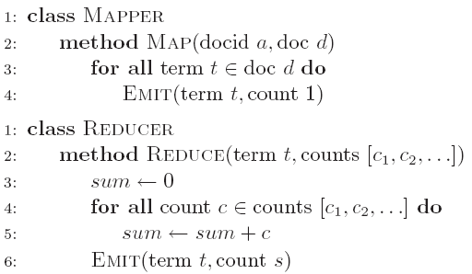
WordCount Step by Step
Input key-value pair
<docid, doc>

Slide 80
WordCount Step by Step
Extract the next term (word) from the document

Slide 81
WordCount Step by Step
Output key-value pair
<term, 1>

Slide 82
WordCount Step by Step
Before the reducer is called, the count for each term is collected into a list

Slide 83
WordCount Step by Step
Input key-value pair
<term, [1, 1, 1 …]>

Slide 84
WordCount Step by Step
Add up the number of 1’s in the value for the given term

